Slide 1
Payment Standard, Gross Rent and rent increase requests
Virginia Housing & Redevelopment Authority

Slide 2
INTRODUCTION
Today
How does the Virginia Housing and Redevelopment Authority (VHRA) establish payment standards.
Rent Increases
How is the tenant portion applied to landlord rent
Including utilities in rent vs tenant paid utilities
Tenant rent increases and how they are calculated
Reasonable rent calculations

Slide 3

INTRODUCTION
HUD publishes the new Fair Market Rents (FMR), which generally become effective on October 1. When HUD updates its FMR’s, the Public Housing Authority (PHA) must update its Payment Standards if the standards are no longer within the basic range. The Payment Standards must be within 90%-110% of the new FMR. Per the Virginia Housing and Redevelopment Authority (VHRA) Admin Plan, changes to Payment Standard amounts will be effective on January 1 of every year or within three months of the FMR effective date, whichever is earlier.

Slide 4
FMR and Payment standards
​ | 0 Bedroom | 1 Bedroom | 2 Bedroom | 3 Bedroom​ | 4 Bedroom | 5 Bedroom
2026 FMR | $849 | $978 | $1,232 | $1689 | $2,067 | $2,377
Payment Standard | $765 | $940 | $1,160 | $1,535 | $1,861 | $2,140
Payment Standard As % of FMR | 90%​ | 96%​ | 94% | 91% | 90% | 90%

Slide 5

Payment Standards
Once Payment Standards for the upcoming year are calculated, they must be approved by the VHRA Board of Commissioners at the September Board meeting and will go into effect on January 1.
When do the new Payment Standards go into effect for tenants?

Slide 6


Payment Standards
Payment Standards go into effect when a tenant moves into a new unit. For existing tenants, the new payment standard will go into effect at their next annual reexam.
For example……………….

Slide 7

Payment Standards
Tenant’s annual reexam is due on 6/1/23, however, tenant moves into a new unit on 3/1/23. The new payment standard will apply.
Tenant’s annual reexam is due on 6/1/23. The payment standard at the 6/1/22 annual reexam was $785 for a 1 bedroom voucher. The new payment standard of $835 will not go into effect for this tenant until 6/1/23.

Slide 8
Payment Standards
New payment standards are not necessarily the new rent amounts, they are a rent limit for tenants participating in the HVC (section 8) program. The subsidized section 8 tenants gross rent must be the same for non assisted tenants per HUD regulation.
“By accepting each monthly housing assistance payment from the PHA, the owner certifies that the rent to the owner is not more than the rent charged by the owner for comparable unassisted units in the premises. The owner must give the PHA information requested by the PHA on rents charged by the owner for other units in the premises or elsewhere”. (CFR 982.507,d)

Slide 9

Rent increase
Rent increases are not allowed during the initial HAP contract (first 12 months).The PHA does require a 12 month lease. Once the initial 12 months have passed, landlords can request rent increases. The PHA must receive the rent increase request at least 60 days before the new rent can go into effect. Rent increase requests will go into effect the first of the month following the 60 day period. A request for an increase for August 1 would need to be received before June 1.

Slide 10
Rent increase
Tenant has been with the HCV program for 3 years. Tenant’s annual reexam is due on 6/1/23. landlord requests an increase in rent from $785 to $835. The request needs to be received before April 1. The new payment standard would apply as 6/1/23 is the annual reexam date.
Same tenant’s annual reexam is due on 6/1/23. Landlord requests a rent increase from $785 to $835 for April 1 and the landlord provided proper notice for the rent increase. The PHA can complete the rent increase for April 1, however, the tenant will pay the difference between $835 and $785 ($50) until the annual reexam calculation would go into effect.

Slide 11


Gross rent
Gross rent is the amount of rent charged by the landlord + any tenant paid utilities (amounts from utility allowance sheet). Landlord charges $785 and utilities are included, gross rent is $785.

Slide 12
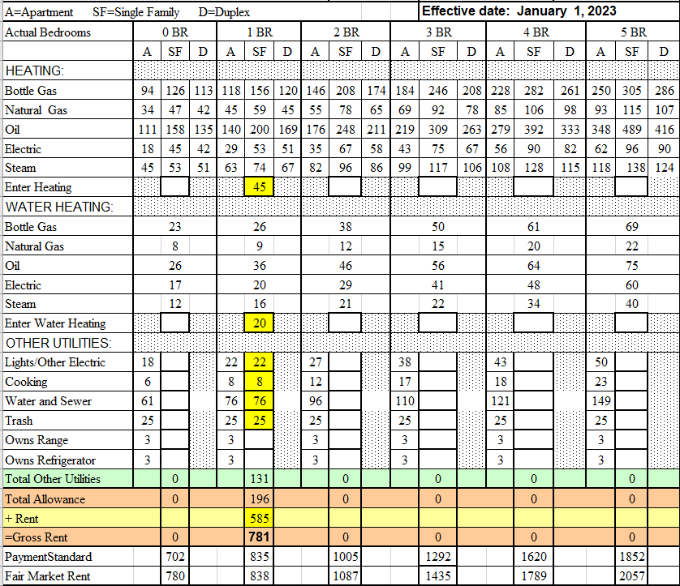
Gross rent
Landlord charges $585 for the rental unit and tenant pays utilities.
1 bedroom voucher and 1 bedroom duplex. Utilities include, natural gas heat, electric hot water, lights/other electric, cooking, water and sewer and trash.
In this example, Gross rent is $781.

Slide 13
Rent Reasonable
In order to be eligible, the dwelling unit must have a reasonable rent, the rent must be in relation to comparable unassisted units in the area and must not be in excess of rents charged by the owner for comparable, unassisted units on the premises.
The PHA cannot approve a lease until the PHA determines that the initial rent to owner is a reasonable rent.

Slide 14
Rent Reasonable
The PHA must determine reasonable rent at:
Initial lease
Before any increase in rent to the owner
If there is a 10 decrease in the published Fair Market Rents in effect 60 days before the contract anniversary as compared with he FMR in effect 1 year before the contract anniversary
If directed by HUD
The PHA may also redetermine the reasonable rent at any other time

Slide 15
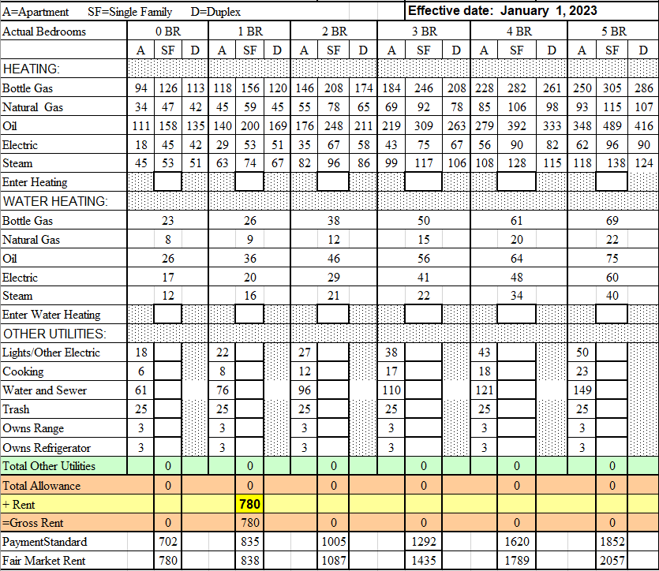
Reasonable rent
When utilities are included in rent, gross rent is the amount of rent. In this case, rent is $780. The PHA will need to compare $780 to other 1 bedroom units in its reasonable rent data base.

Slide 16
Reasonable rent
When tenant pays utilities, gross rent is what the PHA uses to calculate reasonable rent. In this case, rent is $585, however, gross rent is $781. The PHA will need to compare $781 to other 1 bedroom units in its reasonable rent data base

Slide 17
Reasonable rent
At all times during the assisted tenancy, the rent to owner may not exceed the reasonable rent as most recently determined or redetermined by the PHA.

Slide 18

Rent Reasonable
It is important that landlords work with the PHA in obtaining reasonable rent comparables. This allows the PHA to allow tenants to continue to rent units in markets where rent is increasing.

Slide 19

Questions

